Slide 1
QUICK AUTOMATION -
A NEW APPROACH WITH KARATE
SEPTEMBER 2022
NBCU QE Team

Slide 2
Contents
1
Introduction to Karate
2
Karate Setup
3
Karate for API and UI
4
Comparison with Cucumber
5
Pros and Cons

Slide 3



Introduction to Karate framework
Karate is an open-source framework for API & UI Test automation that uses BDD style syntax, has a rich assertion library, built-in HTML reports.
Karate framework follows the Cucumber style of writing the program which follows the BDD approach. The syntax is easy to understand by non-programmers. And this framework is the only API testing tool that has combined API Automation and performance testing into a single standalone tool.
It is designed to be easy for non-programmers. This feature is a game-changer as it allows for more use and access by many people regardless of their technical background or capacity.
It makes use of the Cucumber feature file and the Gherkins language to write the test which is very easy to understand.

Slide 4

Karate Setup
Tools Required For Working With Karate Framework
1) Eclipse
We could even use IntelliJ, Visual Studio, and other different editors available in the market.
2) Build Management Tool
We could use Maven or any other build management tool.
While working in Maven, use Maven dependencies that would help you support Karate Framework.
The following dependencies will be used with Maven in pom.xml.
1. karate-apache
2. karate-junit
The latest versions will be available in the Maven repository.

Slide 5
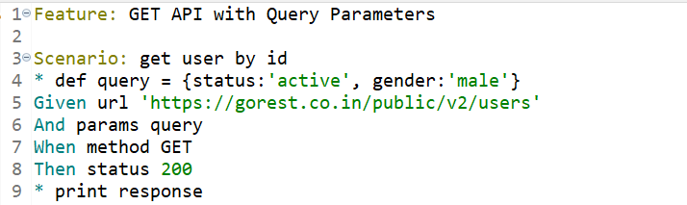
Karate for API
Karate is an open-source API test automation tool. API tests are written using Behaviour Driven Development (BDD) Gherkin syntax.

Slide 6
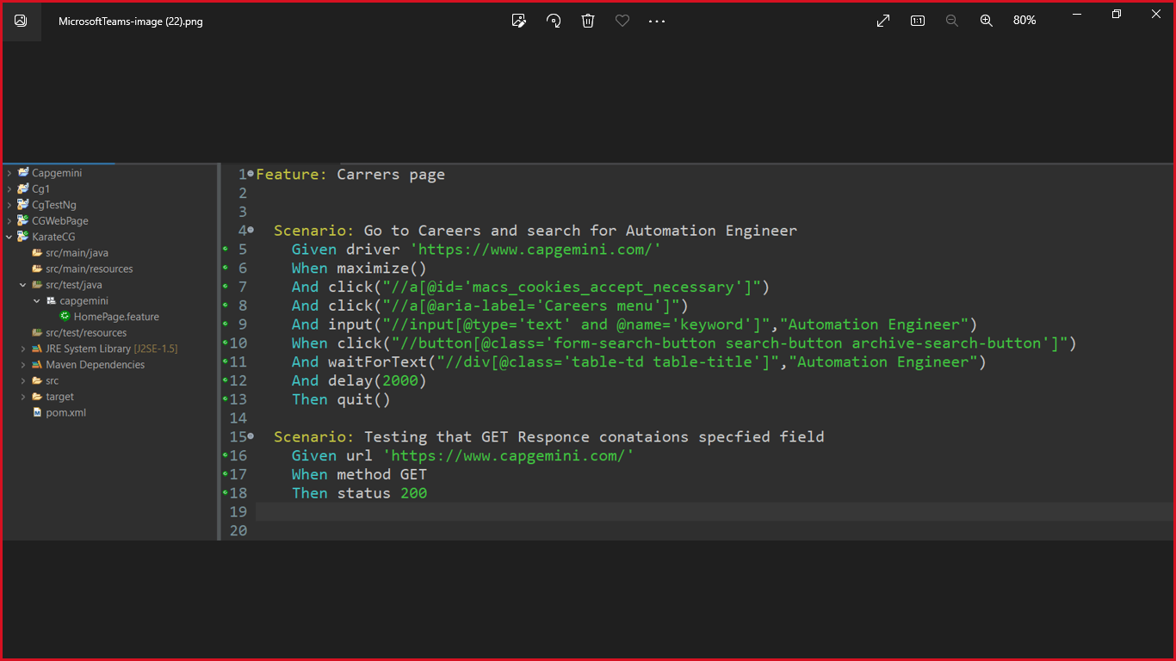
Karate for UI
A feature file is starting point to the karate test.
This is a file where we will describe our tests in Descriptive language
Simple feature file format:
Scenario : sample title of the scenario
Given : want to write a step with pre condition
When : complete action
Then : validate the action outcome

Slide 7
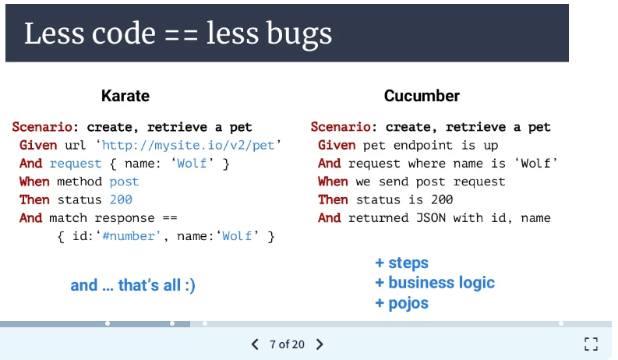
Comparison of Karate with Cucumber Framework
Karate is built on top of cucumber.
Use of the Gherkin file.
Understanding by non programmers.
Karate support both API and UI testing but cucumber support only UI.
Karate makes no use of java while testing, but cucumber does.
Karate has only one layer but cucumber has two.
Parallel execution.

Slide 8
PROS and CONS of Karate Framework
PROS
Easy to start with little coding.
In Karate one can write JSON expression right within feature file.
Karate features a very powerful JSON validation
Karate one do coding in JS or java.
It has detailed logs and reporting.
CONS
Karate uses its own scripting language.
Finding errors in code is not easy.
No Syntax Error Highlighting.

